Slide 1
Analytics Server Setup (3131)
Phase 3: Data Management and Storage
April 13, 2018
Rajashree Joshi, Yuchen Li

Slide 2
Current Situations
Analytics Server (0852)
MarketScan, data mentors, client data
Python, R , SAS enabled
Very crowded
NIKE Server (1465)
MarketScan data
SAS enabled
Python/R not available

Slide 3
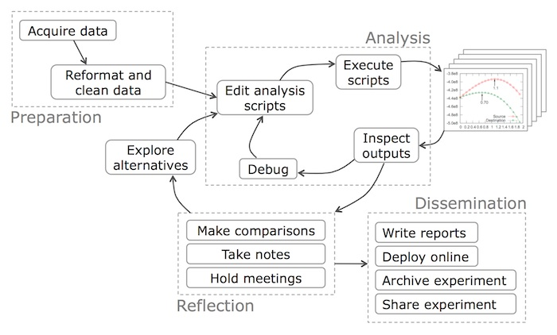
Data Science Workflow
Objective
Preparation
Import data
Data exploration and cleaning
Analysis and Reflection
Baseline model
Secondary model
Dissemination
Deployment/production

Slide 4
Objectives
Build a team (ACE) development server
Development server will:
Run final models only (i.e., for incorporation into products such as Flexible Analytics)
Archive final code, metadata, and relevant train/test/output datasets (HIPAA)
Interface with production/engineering teams (e.g., through use of Docker)
Build a team (ACE) sandbox server
Sandbox server will:
Provide space for model fitting and testing
Archive code, metadata, and relevant train/test/output datasets (HIPAA)
Interface with development server (e.g., through use of Docker)

Slide 5
The Building Blocks
Capacity: storage and computing power
To accommodate 20-30 users on ongoing basis
Connectivity: access to in-house data sources
Compatibility: version control, standardization
Compliance: HIPAA and general client data guidelines

Slide 6
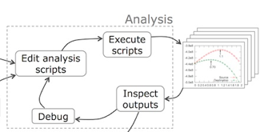
Solutions
Capacity: storage and computing power
In-house physical server with attached distributed computing capacity
Physical Server
Distributed computing environment
Storage

Slide 7
Solutions
Connectivity: access to MarketScan, data mentor and etc.
Attached storage with NFS/Sand mount to 0852 and 1465 server
1465: NIKE
Physical Server
Distributed computing environment
0852: Analytic
Storage

Slide 8
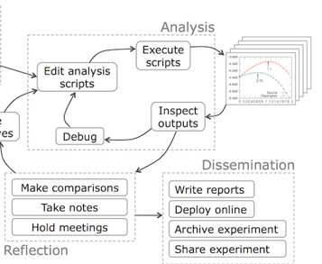
Solutions
Compatibility: version control, standardization
Version control: Git
Standardization: Docker

Slide 9
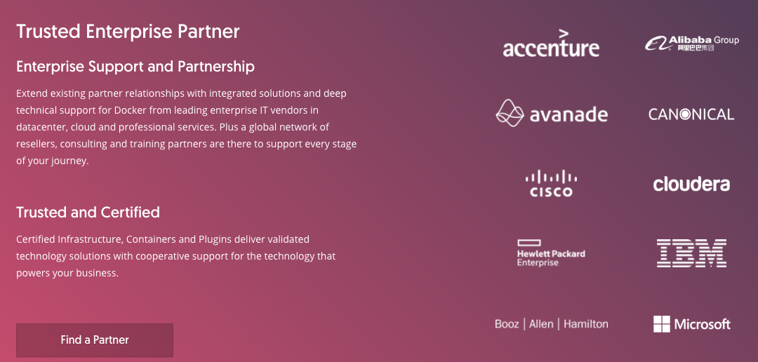
What is Docker?
Docker is an realization of container technology. A container image is a lightweight, stand-alone, executable package of a piece of software that includes everything needed to run it: code, runtime, system tools, system libraries, settings.

Slide 10
Benefit of Docker
Standardization
Rather than building a new environment for every analysis, you can put the tools and packages required for certain types of analyses (e.g., SAS, python, etc.) into a container, create an image of that container, and have every user boot up an isolated, standardized environment from that image
Resource control
By default, a Docker image has no resource constraints and can use as much of a given resource as the host’s kernel scheduler allows. Docker provides ways to control how much memory, CPU, or block IO an image can use

Slide 11
Solutions
Compliance: HIPAA and general client data guidelines
Ensure the confidentiality, integrity, and availability of all e-PHI they create, receive, maintain or transmit
Identify and protect against reasonably anticipated threats to the security or integrity of the information
Protect against reasonably anticipated, impermissible uses or disclosures; and
Ensure compliance by their workforce

Slide 12
Development vs. Sandbox Server
 | Development | Sandbox
Timing | Completed | Immediately
Data restrictions | General HIPAA, client data guidelines | General HIPAA, client data guidelines
CPU | 12 virtual cores per virtual machine | 24 physical cores
Storage | 5TB | 5TB
RAM | 128GB | 512GB
Operating system | Red Hat Enterprise Linux 7.3 | Red Hat Enterprise Linux 7.3
Data access | NA | NFTS mount to 0852 and 1465 server
3rd party software | Docker(17.06.2-ee-6), Flexible Analytics (via API) | Docker(17.06.2-ee-6), Flexible Analytics (via API), Anaconda Python(>=3.6: pandas, numpy, sklearn), R and Rstudio, SQL, Git, Git LFS, Jupyter Notebook
Access/users | Restricted access to and control by project/development lead | Restricted and unrestricted access to and control by ACE users

Slide 13
Current Status - “DEV” and “SANDBOX” servers
“Dev” server
Received “Dev” server in Jan 2018.
The CCM Medicaid team has access and will be using it for analytic code testing for large data sample. The team will also use this server to do final testing, wrap code in docker file before shipping it to Flexible Analytics for deployment. Access to all other team members will be provided soon
“Sandbox” (3131) server
Received “Sandbox” (3131) server during the first week of March.
Rajashree will forward instructions to request access to the sandbox server. Managers can request access for each of their team members.

Slide 14
Timeline - “SANDBOX” （3131） server
3/4/18:
There is currently no data or tools or packages loaded on this server. Sometime this week, once approval is received to copy data for SDoH (Social Determinant of Health) project from 0852 server, packages and data used for SDoH will be copied and loaded to the sandbox server as this project is deemed high priority.
3/19/18:
R and Python with standard/native packages installed
Daily back-up scheduled
Folder structure proposed: project and user folder
Archive solution proposed
EMR/CED data currently not available
SDoH data copied and loaded
4/13/18: confirmed with Dino regarding Python version and server specs
Python version 3.6
24 cores, 512 GB of memory

Slide 15
Timeline - “SANDBOX” （3131） server
4/24/18:
Folder structure guideline version 1 completed and uploaded to Box
4/26/18:
‘ACE’ folder on 3131 and 0852 is now a shared folder on both server

Slide 16
Short and Long Term Approaches for Data Management and Storage
Short Term Approaches
Copy all needed data to 3131 server - MarketScan, SAF, and etc. with appropriate approvals from Data Governance
Run SAS queries on 0852 or 1465 servers, create csv files and SCP to 3131 for analytic work, again with appropriate approvals from Data Governance
Medium to Long Term approaches
Network-attached storage (NAS): a Network Attached Storage (NAS) device is a storage device connected to a network that allows storage and retrieval of data from a centralized location for authorized network users.
The idea is to have a copy of MarketScan, SAF data, and etc., onto the NAS so that all the users in ACE team can access those files.
One of the main advantage is we can access the files from any Truven servers (0852, 3131, 1465 and etc.).

Slide 17
Short Approaches for Data Management and Storage: Pros and Cons
Short Term Approaches
Copy all needed data to 3131 server - MarketScan, SAF, and etc. with appropriate approvals from Data Governance
Run SAS queries on 0852 or 1465 servers, create csv files and SCP to 3131 for analytic work, again with appropriate approvals from Data Governance
Pros:
Less time consuming than to SAS/SCP data from 0852/1465 to 3131 for each project
Preserves all variables
Cons:
Does not update accordingly to changes made to MarketScan
Querying CSV data is slower than SAS data
Pros:
Fast queries (than query in CSV)
Fresh update
Cons:
SCP takes time for larger (in GB) data

Slide 18
Short and Long Term Approaches for Data Management and Storage
Medium to Long Term approaches
Apache Hive: The Apache Hive data warehouse software facilitates reading, writing, and managing large datasets residing in distributed storage using SQL.
It is built on top of Apache Hadoop. Look into creating hive tables out of the MarketScan and other data sets and have these tables reside in Hadoop Server.
The main advantage is we can process large data sets in short amount of time and transfer the processed output to the Sandbox server (3131) using SCP.
DB2: DB2 is a database product from IBM. It is a Relational Database Management System (RDBMS).
It is designed to store, analyze and retrieve the data efficiently. One option is to move data into DB2. The DB2 instance will be created on Hadoop Server.
We can contact Gigi's team to discuss about this option since they have transferred some of the MarketScan data into DB2.
DB2 is not free & we need to get an estimate of the costs and resources needed to move the MarketScan data into DB2.
IBM Db2 Big SQL : https://www.ibm.com/us-en/marketplace/big-sql

Slide 19
Access to EMR（Explorys) Data
No change from current access or process

Slide 20
Maintenance
General issue:
Submit ticket through: https://apps.na.collabserv.com/wikis/home?lang=en-us#!/wiki/W1f1fdb4b2ab6_4646_b124_3195f2816bb9/page/Engage%20CET%20iSupport

